Slide 1

Distributed Systems Week 1 - Introduction
Peter Vargovcik
peter.vargovcik@tus.ie

Slide 2
Distributed System
An application consists of a number of nodes each communicating with each other.
Act as a single computer (e.g. B2C)
Often communicate using some form of message passing.
Between processes, systems, sensors
Distributed Systems - Week 1: Introduction

Slide 3
Distributed Systems v Parallel Systems
Distributed Systems
Each node has its own memory.
[Communicating PCs.]
Parallel Processing
A number of CPUs with access to shared memory.
[Multi-processor/multi-core CPU]
Distributed Systems - Week 1: Introduction

Slide 4
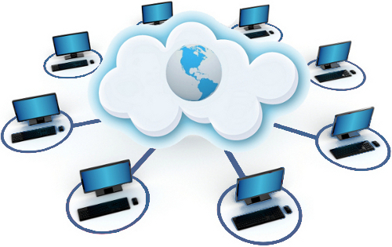
Why a Distributed System
The application itself is distributed, for example, data is produced in one physical location and used somewhere else.
We want the application to scale and to achieve this we need a number of machines working together.
Distributed Systems - Week 1: Introduction

Slide 5
Challenges
Design software and hardware so that they provide the desirable characteristics of distributed systems while minimizing problems inherent in those systems.
Programming language
Connection
Relevant issues of distributed system design are resource identification, communication, quality of service, and software architecture.
Computers operate concurrently and can fail independently
Distributed Systems - Week 1: Introduction

Slide 6
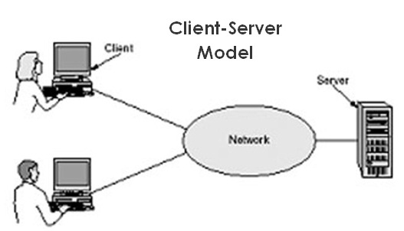
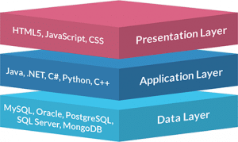
Distributed Systems – Some Architectures
Client/Server
Relational database systems
Clients connect directly to a database server.
Query data and process the results.
3-tier architectures (Web)
Client (Browser)
Middle Tier – Domain Objects
Data Tier – Database
Distributed Systems - Week 1: Introduction

Slide 7
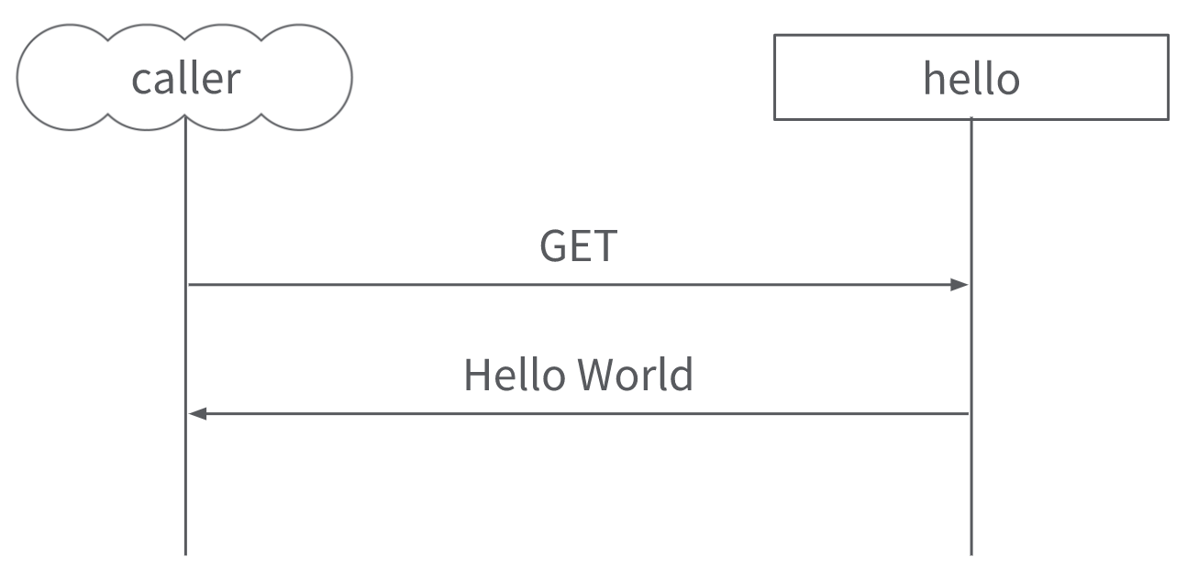
Distributed Systems – Some Architectures
Representational state transfer (REST) applications
Server produces XML/JSON.
Client sends HTTP request and parses the responses.
Peer to Peer (BitTorrent etc.)
Distributed Data
Relational
NoSQL.
Distributed Systems - Week 1: Introduction

Slide 8
Distributed Systems - Topics
TCP/IP Sockets
REST – JAX-RS
XML parsing
Messaging – RabbitMQ
Distributed Data – NoSQL/MongoDB
Distributed Systems - Week 1: Introduction

Slide 9
Continuous Assessment
40% for class assessments (CA)
Final Exam 60%
Distributed Systems - Week 1: Introduction

